Slide 1
Coptic Lesson 12
The Lord's Prayer in Coptic

Slide 2
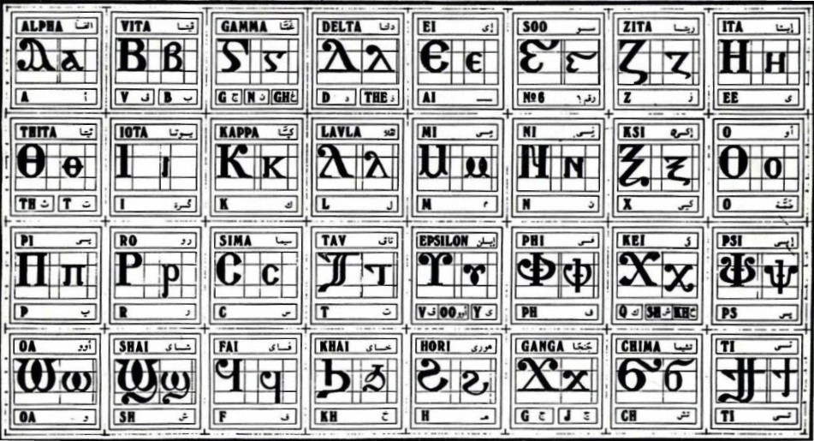
Coptic Alphabets

Slide 3
Coptic Alphabets Review
Coptic English Name
G
g, gh, n
Ghamma
A
a
Alpha
}
ti
Tee
c
s
Seema
y
ee
Eata
Q q
kh
Khay
,
k, sh, kh
Kee

Slide 4
Coptic Reading – Part 1
na ne ni no nw
fa fe fi fo fou
ra re ri ro rw
ta te ti to tou
ha he hi ho hw
ja je ji jo jw
naf neh nit noj nwr
far fet fin foh fwi
ran ref rit ror rwf
taj ten tin tor tour

Slide 5

Lord's Prayer Preview Video

Slide 6
The Lord's Prayer
Qen `vran `m`viwt nem `Psyri nem Pi`pneuma `e;ouab ounou] `nouwt@ `amyn.
Ariten `nem`psa enjwc qen ousep`hmot@
Je Peniwt etqen nivyou`i@ mareftoubo `nje pekran@
marec``i `nje tekmetouro@ petehnak marefswpi
``m`vry] qen `tve nem hijen pikahi@
penwik `nte rac] myif nan `mvoou@
ouoh ,a ny`eteron nan `ebol

Slide 7
The Lord's Prayer – Part 2
`m`vry] hwn `nten,w `ebol `nny`ete ouon `ntan erwou@
ouoh `mperenten `eqoun `epiracmoc@
alla nahmen `ebolha pipethwou@
qen Pi`,ryctoc Iycouc Pen[oic@
je ;wk te ]metouro nem ]jom nem piwou sa `eneh@ amyn.
Qen `vran `m`viwt nem `Psyri nem Pi`pneuma `e;ouab ounou] `nouwt@ `amyn.

Slide 8
Crossing Ourselves
Qen `vran `m`viwt nem `Psyri nem Pi`pneuma `e;ouab ounou] `nouwt@ `amyn.
qen
in, with, by, at
ran
name
iwt
Father
Syri
Son
Nou]
God
ouwt
single, one

Slide 9
Introduction
Ariten `nem`psa enjwc qen ousep`hmot@ Make us worthy to say in thanksgiving:
Ari-
do, make
em`psa
to be worthy
jw
to say, to sing
sep`hmot
to give thanks

Slide 10
Part 1 of the Lord's Prayer
Je Peniwt etqen nivyou`i@ Our Father who art in the heavens,
mareftoubo `nje pekran@ hallowed by Thy Name.
Je
"…", for, because
ve
heaven, sky
Vyou`i
heavens
toubo
to clean, purify, be holy
`nje
namely, that is

Slide 11
Part 2 of the Lord's Prayer
marec``i `nje tekmetouro@ Thy Kingdom come,
petehnak marefswpi Thy will be done
`i
to come
`nje
namely, that is
metouro
kingdom
`hna//
to will, to desire
swpi
to become, happen

Slide 12
Part 3 of the Lord's Prayer
`m`vry] qen `tve nem hijen pikahi@ on earth as it is in heaven,
`m`vry]
as, like
nem
and, with
hijen
upon, over
kahi
earth, soil
pi> `p> `v
the (masculine)

Slide 13
Part 4 of the Lord's Prayer
penwik `nte rac] myif nan `mvoou@ Give us this day our bread of tomorrow.
wik
bread
`nte
of
rac]
tomorrow
nan
to us
`mvoou
today

Slide 14
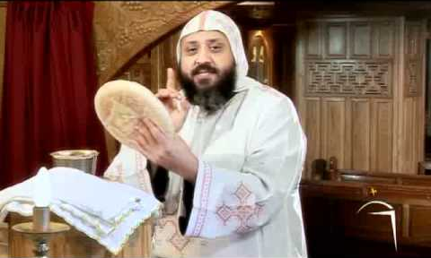
The Bread of Tomorrow
"And do not seek what you should eat or what you should drink, nor have an anxious mind… But seek the kingdom of God, and all these things shall be added to you." Luke 12:29-31

Slide 15
Part 5 of the Lord's Prayer
ouoh ,a ny`eteron nan `ebol and forgive us our debts
`m`vry] hwn `nten,w `ebol `nny`ete ouon `ntan erwou@ as we forgive our debtors
ouoh
and
,w
to put
`ebol
out, away
hwn
too, also
ny`ete
those who

Slide 16
Part 6 of the Lord's Prayer
ouoh `mperenten `eqoun `epiracmoc@ and lead us not into temptation
alla nahmen `ebolha pipethwou@ but deliver us from evil
`eqoun
into
alla
but, however
nahmen
save us
`ebolha
away from
hwou
evil, bad

Slide 17
Part 7 of the Lord's Prayer
qen Pi`,ryctoc Iycouc Pen[oic@ in Christ Jesus our Lord,
je ;wk te ]metouro nem ]jom nem piwou sa `eneh@ amyn. For Thine is the kingdom, the power and the glory, for ever, Amen.
;wk
Yours, Thine
ouro
King
metouro
Kingdom

Slide 18
Part 8 of the Lord's Prayer
Qen `vran `m`viwt nem `Psyri nem Pi`pneuma `e;ouab ounou] `nouwt@ `amyn.
jom
power, strength
wou
glory
sa `eneh
forever, eternally

Slide 19
Questions
Ari....... `nem`psa en....... qen ou...............@
Je Pen....... et....... ni.............
maref.......... `nje pek.........
Marec..... `nje tek.............
pete........ maref..........
`m`vry] ...... `tve nem ........... pi..........
pen....... `nte .......... myif nan ............
ouoh ....... ny`eteron nan .......... `m`vry] ........ `nten...... `ebol `nny`ete ............ `ntan `erwou
ten
jwc
sep`hmot
iwt
qen
Vyou`i
toubo
ran
`i
metouro
hnak
swpi
qen
hijen
kahi
wik
rac]
`mvoou

Slide 20
Vocabulary List
qen
in, with, by, at
ran
name
[oic
Lord
Syri
Son
Nou]
God
ouwt
single, one
ouro
King

Slide 21
Announcement

Slide 22

Oujai qen `P[oic

